Slide 1

Chapter 10:
Simulation Modeling
© 2007 Pearson Education

Slide 2
Simulation
To simulate is to try to duplicate the characteristics of a real system
We will study mathematical simulation models of real systems to help make business decisions
Simulation is one of the most widely used decision modeling techniques

Slide 3
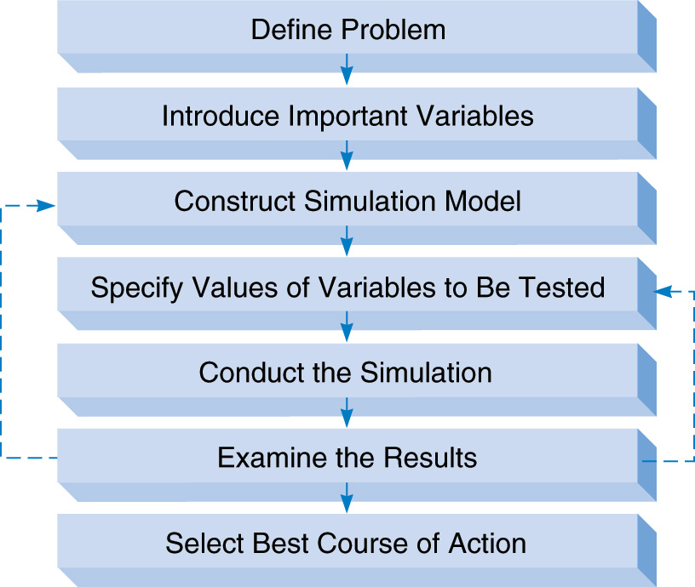
The Process of Simulation

Slide 4
Advantages of Simulation
Flexibility
Can handle large and complex systems
Can answer “what-if” questions
Does not interfere with the real system
Allows study of interaction among variables
“Time compression” is possible
Handles complications that other methods can’t

Slide 5
Disadvantages of Simulation
Can be expensive and time consuming
Does not generate optimal solutions
Managers must choose solutions they want to try (“what-if” scenarios)
Each model is unique

Slide 6
Monte Carlo Simulation
Can be used with variables that are probabilistic
Steps:
  Determine the probability distribution for each random variable
  Use random numbers to generate random values
  Repeat for some number of replications

Slide 7
Random Variables (RV’s)
There are many random variables in real life where there is uncertainty, such as:
  Product demand
  Lead time for orders
  Time between equipment breakdown
  Service time
  Etc.

Slide 8
Step 1: Determine the Probability Distribution for Each RV
There are many different probability distributions (e.g. general discrete, normal, Poisson, uniform, exponential, binomial, etc.)
Usually use historical data to determine which distribution “fits” best

Slide 9
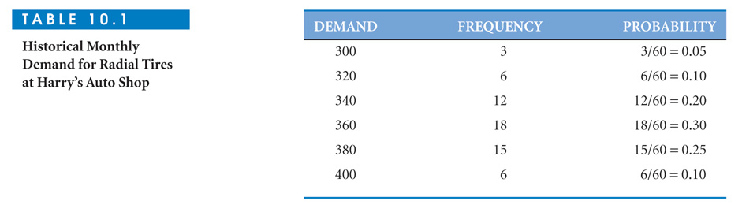
Harry’s Auto Shop Example
Want to simulate monthly demand for tires
Have data on past 60 months

Slide 10
Step 2: Use Random Numbers to Generate Random Values
Random numbers are where all values are equally likely
Rolling a single die generates random numbers between 1 and 6
Using two-digit random numbers (00 to 99) the probability of each is 1/100 or 0.01
Random numbers can be come from a computer, a table, a roulette wheel, etc.

Slide 11
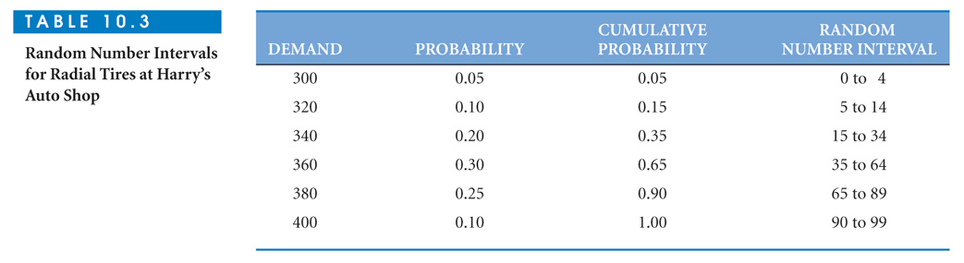
Random Number Intervals for Harry’s Auto Shop

Slide 12
Step 3:
Replication of the Simulation
Repeatedly draw a random number and determine the demand for a particular month
A simulation must be replicated (or repeated) many times to cover the full range of variability and obtain meaningful results

Slide 13
Role of Computers in Simulation
The Harry’s example was done “by hand”
Computers are much faster
Software packages have built-in procedures for a variety of probability distributions
Replications are kept track of

Slide 14
Simulation Software Packages
General purpose languages
(Visual Basic, C++, Fortran, etc.)
Special purpose languages and programs
  (GPSS, Simscript, Microsaint, BuildSim, etc.)
Spreadsheet models

Slide 15
Generating Random Values in Excel
To generate random numbers between 0 and 1, use: = RAND()
Using this with various formulas allows generating RV’s from a variety of distributions, including normal, uniform, exponential, and general discrete
Go to Excel

Slide 16
Return to Harry’s Auto Shop
Want to compute expected profit
Revenue per tire varies with market conditions
  Discrete uniform distribution $60 to $80
Profit margin per tire also varies
  Continuous uniform distribution, 20% to 30%
Fixed operating cost is $2000 per month

Slide 17
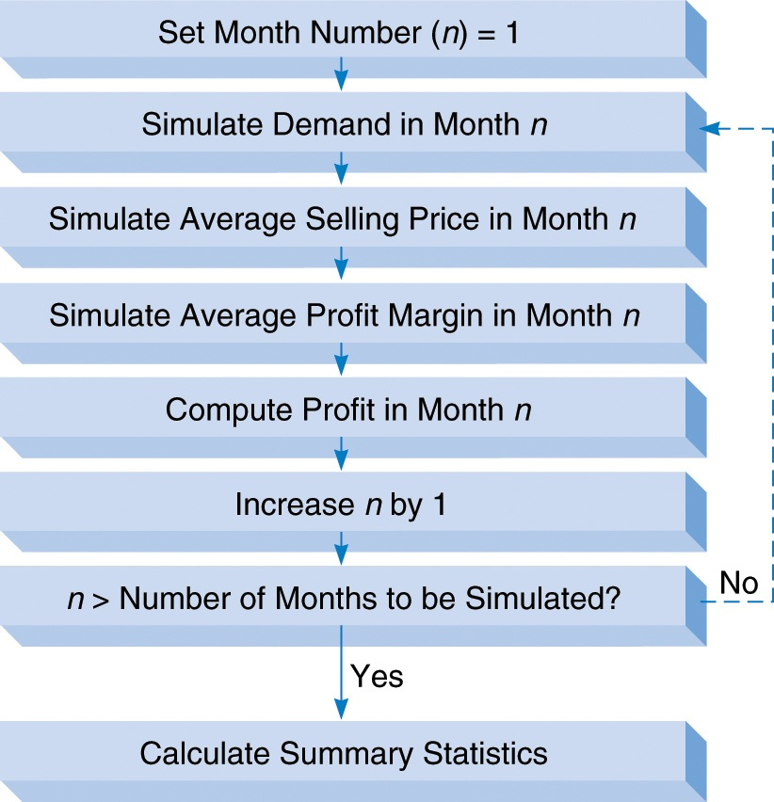
Flowchart for Harry’s Simulation
Go to file 10-2.xls

Slide 18
Replicating the Model
If model is small it could be copied multiple times
Using a Data Table for replication is convenient for larger models
For each value (run number) in the data table, the model is run and the result reported
Go to file 10-2.xls

Slide 19
Example Inventory Simulation
Simkin’s Hardware Store
Selling electric drills
Decisions
  How many drills to order?
  When to order more drills?
Random Variables
  Daily demand
  Lead time (time from order placement until order received)

Slide 20
Simkin’s Inventory Objectives
Avoid stockouts (because customer will buy at another store)
Keep inventory levels low
Avoid ordering too frequently
These objectives conflict
Costs are associated with each, so total cost can be calculated

Slide 21
Components of Total Cost
Type of Cost | Cost
Stockout (lost sale) cost | $8 per drill
Holding (inventory) cost | $0.02 per drill per day
Order cost | $20 per order
Want to find the inventory policy that minimizes total cost

Slide 22
Inventory Policy
Inventory policy decision variables (Q, R)
Q = the number of drills to order
R = the reorder point
(if inventory < R, an order is placed)
We can try “what-if” (Q, R) combinations to look for the lowest cost policy

Slide 23
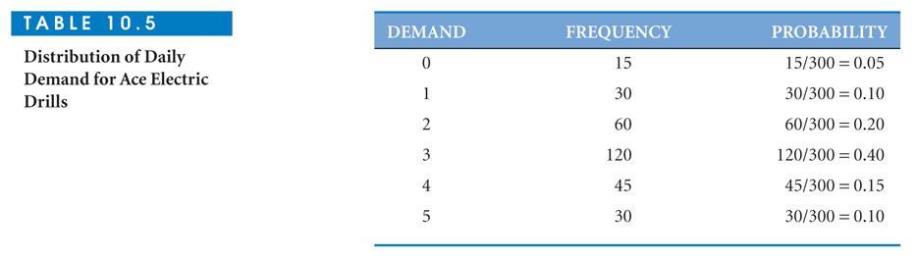
Probability Distribution of Daily Drill Demand
Probability distribution of lead time:
Uniform from 1 to 3 days

Slide 24
Simulation Model
Simulate 25 days of operation
Start day 1 with 7 drills in inventory
Generate random demand each day
Demand filled = Minimum of inventory and demand
If demand > inventory, then stockout(s) occur

Slide 25
Simulation Model
Track inventory level
  Reduced when drills are sold
  Increased when orders arrive
Place an order for Q drills if the day’s ending inventory < R
Each time an order is placed, generate a random value for lead time
Calculate all 3 types of cost and sum for total cost
Go to file 10-3.xls

Slide 26
Replication Using Data Table
Can record all 4 costs (holding, stockout, order, and total cost) for each replication
Each replication represents one month (25 days) of operation
Generate 200 replications
Go to file 10-3.xls

Slide 27
Using Scenario Manager to
Include Decisions in Simulation
Decision variables for Simkin (Q, R)
Try Q values 8, 10, 12, and 14
Try R values of 5 and 8
Excel’s Scenario Manager can automatically run all 8 combinations of Q and R
Go to file 10-3.xls

Slide 28
Example Queuing Simulation
Denton Savings Bank
Banks customers arrive randomly and have random service times
Customer satisfaction criteria:
  Average waiting time < 2 minutes
  Average queue length < 2 customers
Simulate bank operation to determine if criteria are met

Slide 29
Simulation Issues
Need to use discrete event simulation to keep track of clock time
Assume one teller
Start clock at time 0
Simulate arrival of 150 customers

Slide 30
Values to Track for Each Customer
Time since the previous arrival (random)
Arrival time (clock time)
Start service time (clock time)
Service time (random)
End service time (clock time)
Waiting time (duration)
Queue length (including current customer)

Slide 31
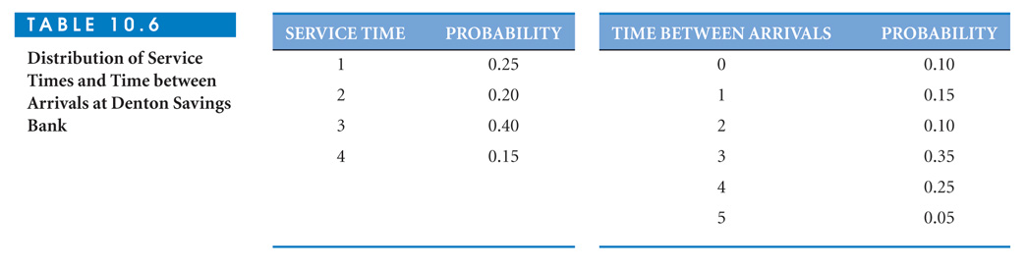
Service Time and
Time Between Arrivals Distributions
Go to File 10-4.xls

Slide 32
Revenue Management Simulation
Revenue management is often used in the airline and hotel industries
Customer demand is uncertain
There is usually some probability that customers with reservations are “no-shows”
Capacity is usually fixed

Slide 33
Judith’s Airport Limousine Service
Considering offering transportation to/from airport (50 miles away)
Average daily demand is 45 people
Would make 4 one-way trips per day
Van capacity is 10 passengers
Judith’s operating cost is $100 per trip
All trips will be made even if the van is empty

Slide 34
Passengers With Reservations
Reservations require a $10 nonrefundable deposit
Reservation ticket price is $35
Reservation demand per trip follows discrete uniform distribution from 7 to 14
20% of people with reservations do not show up
If more than 10 show up, Judith must pay $75 for alternate arrangements (i.e. loss of $75 – $35 = $40)

Slide 35
Walk-up Passengers
Walk-up demand follows a general discrete distribution
Demand Probability
0 0.30
1 0.45
2 0.25
Walk-up passengers pay $50 per trip

Slide 36
Decision Variable:
How many reservations to accept?
(Want to evaluate 10 to 14)
Objective:
Maximize average profit per trip
Go go file 10-5.xls

Slide 37
Simulation With Crystal Ball
Crystal Ball is an add-in for Excel created by Decisioneering Inc.
Included on the text’s CD-ROM
Makes simulation in Excel easier
  Has built-in probability functions
  Have built-in replication procedures
  Make it easier to collect and display information

Slide 38
Using Crystal Ball
Install from the CD-ROM
Start Crystal Ball
You will be in Excel but an additional menu bar will appear for Crystal Ball

Slide 39
Primary Crystal Ball Menu Options
Define Assumption – for specifying the probability distribution for each random variable
Define Forecast – specifies which cell(s) to collect data on
Run Preferences – specifies number of replications
Start Simulation – runs the simulation

Slide 40
Simkin’s Hardware Store
With Crystal Ball
Revisit Simkin’s inventory problem for selling drills
Want to evaluate:
  Q (order quantity) values of 8, 10, 12, and 14
  R (reorder point) values of 5 and 8

Slide 41
Simkin’s Hardware Store
With Crystal Ball
Use the custom distribution for daily demand
Collect data on (Define Forecast) for: holding cost, stock out cost, order cost, and total cost
Go to file 10-6.xls

Slide 42
Simulation of Revenue Management With Crystal Ball
Revisit Judith’s Limousine service
Use binomial distribution for number of no-show reservations (p=0.8)
Use the custom distribution for number of walk-ups
Collect data (Define Forecast) for both profit and occupancy rate
Go to file 10-7.xls

Slide 43
Other Types of Simulation Models
Operational Gaming – where there are 2 or more competing players (such as military games or business games)
Systems Simulation – models the dynamics of a large system (more complex than the Monte Carlo methods we have studied)

